Slide 1
Methodology for Time Series Study

Slide 2
Objective
Find a good time series model to model disease progress of a group of patients who are using the same type of medication

Slide 3
Steps
Preprocessing patients’ data for time series analysis: (imputation/truncation and some tests)
For each type of medication, cluster patients by their IOP, MD and PSD progress (time series clustering)
Fit some time series. Fitness is evaluated using residuals of one-step predictions from the model

Slide 4
Preprocessing Step
Most time series models work with assumptions of evenly spaced time series
Hence, we need to impute data points at interval where patients attributes are not observed
2 candidates for time series imputation:
Kernel Regression Smoothing (non-parametric)
LOESS (noted for good at unevenly spaced time series)
References: Survey: interpolation methods in medical image processing Lehmann, T.M

Slide 5
Preprocessing Steps
In order to identify some other interesting trends in patients’ progress, we could carry out some statistical tests:
Dickey-Fuller Test for Stationary of the series (conventional)
Phillips-Outlaris Test for Cointegration of IOP,MD and PSD series. Presence of cointegration means there is a common stochastic trend behind IOP, MD and PSD (which should be the case!)
Reference: Introductory Time Series in R Paul S.P. Cowpertwait

Slide 6
Clustering Step
Extract all series of a particular medication
Cluster series by the distance between one series’ observation to the rest. If there are 23 observations from the series, there will be 23 centroid for clustering. It is a good idea to detrend/de-mean the series so that we are actually grouping them based on progression. Otherwise, outliers would make noise to the clustering
3 methods to consider:
EM
Hierarchical clustering/dendrogram
Reference: Data Mining and Business Analytics with R chapter 15 for example of time series clustering Johannes Ledolter

Slide 7
Clustering Step
Also of interest: Identify reasons why the series are grouped into the same cluster. What are the common attributes that these patients have so they be clustered into the same group? We cluster patients based purely on their numerical IOP and MD values.

Slide 8
Fit some time series
Average out all series in the same cluster
Fit a specific time series model onto this average-out series
Apply the model to each of the series in the cluster and report statistics
The reason for averaging out series is because time series models are designed to apply to a single series only
Another way to do this is to split into training/testing sets. But that also depends largely on how many patients we have on hand

Slide 9
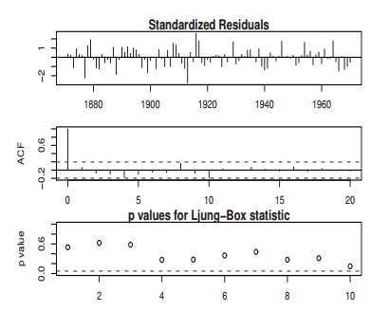
Fit some time series
Some common statistics to report goodness-of-fit in time series:
Others like AIC and BIC are also interesting/important to penalize overly complex models. R implements AIC and BIC for ARIMA families (they include that when fitting parameters for ARIMA). But I don’t think there is a mirror for DLM. Let me check on that again.

Slide 10
Some models of interest
ARIMA families (including AR, MA and ARMA)
Dynamic Linear Models as reported in Schell
VARIMA families – mirrors of ARIMA but designed for cointegrated series. That means we have reasons to believe MD and IOP are cointegrated. Interesting but we should see how that performs
ARCH families
References: Time Series Analysis With Applications in R Cryer,Jonathan D.
Big thanks to R for providing all implementations for methods discussed

